Slide 1

Nutan Rajumani Transport (P) Ltd
Cold storage
Since 1965
Celebrating 50 glorious years

Slide 2

OUR MOTTO AND VISION
MOTTO
Don’t wait for chances, Create opportunities.
VISION
To be the leading logistics service provider in India.

Slide 3
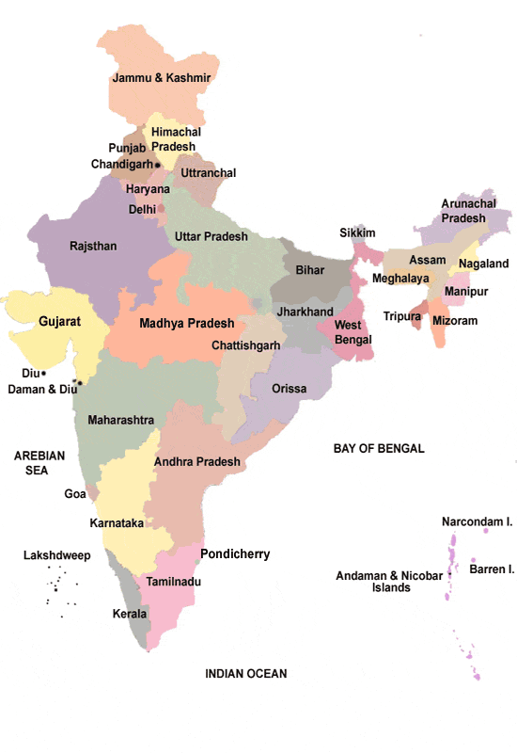
CLIENTELE
ITC LTD
ASIAN PAINTS LTD
AMUL
GENERAL MILLS
WAGH BAKRI TEA
D MART
MONDELEZ
Guiltfree Ind
Delhivery
Hitachi ABB

Slide 4
NRT journey
Establish 1965
1972 ITC / Parle / ICI / Voltas
1985 Started 1st CFA / Parle
1990 Silver Jubilee Year
2009-12 APL/ WG tea /Entered South
1970
Branches across Mah. /Raj./ Guj.
1988 ITC 1st CFA/ Gujarat
2006 – 2008
Spread presence in North
2013-16
D mart /Castrol/Amul / Delhivery / Entered East

Slide 5

Hierarchy….
MD
Operation/ Fleet Div. Head
Operation Manager- HO
Fleet Manager- HO
Finance Director
Finance manager -HO
Regional Operation Manager
Regional Fleet Manager
Regional Finance Manager
Transport Manager
CFA Manager
Accountant

Slide 6
NRT assets….
People
Processes
Fleets
Warehouse Space
Dedicated team comprising of 45 managers, 450+ supervisors.
Own vehicles strength of 200 vehicles, additionally 350+ in house attached vehicles.
Emphasis on containerized body vehicles ensuring safety of stocks and customer need.
Robust process of warehousing and transportation, ensuring delighted customer levels
Managing warehousing Space 22 lac + sq.ft. Pan India.

Slide 7
Warehousing & Transportation Foot Print
Maharashtra
Gujarat
Rajasthan
Madhya Pradesh
Uttar Pradesh
Uttrakhand
Andhra Pradesh
Karnataka
Telangana
West Bengal
250000 sq.ft. warehousing + Transportation
187000 sq.ft. warehousing + Transportation
180000 sq.ft. warehousing + Transportation
Transportation
50000 sq.ft. warehousing + Transportation
65000 sq.ft. warehousing + Transportation
1070000 sq.ft. warehousing + Transportation
200000 sq.ft. warehousing + Transportation
Transportation
Transportation

Slide 8
NRTPL – Achievements
End 2 End Solution
Achievement & Awards
Customer Delight
Expertise in stocks handling, storage, and transportation since past 50 years.
Awarded best logistics service provider by ITC for last 5 consecutive years & Asian Paints
On time execution & delivery of stocks.

Slide 9
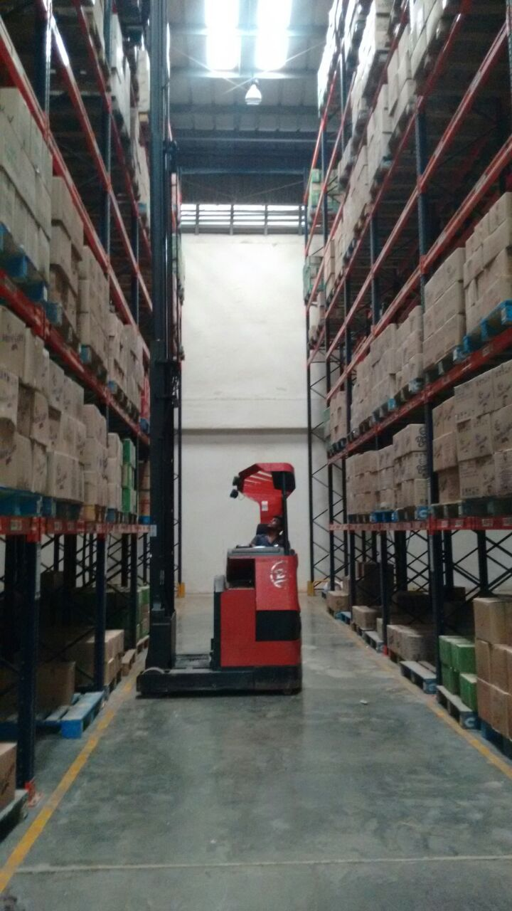
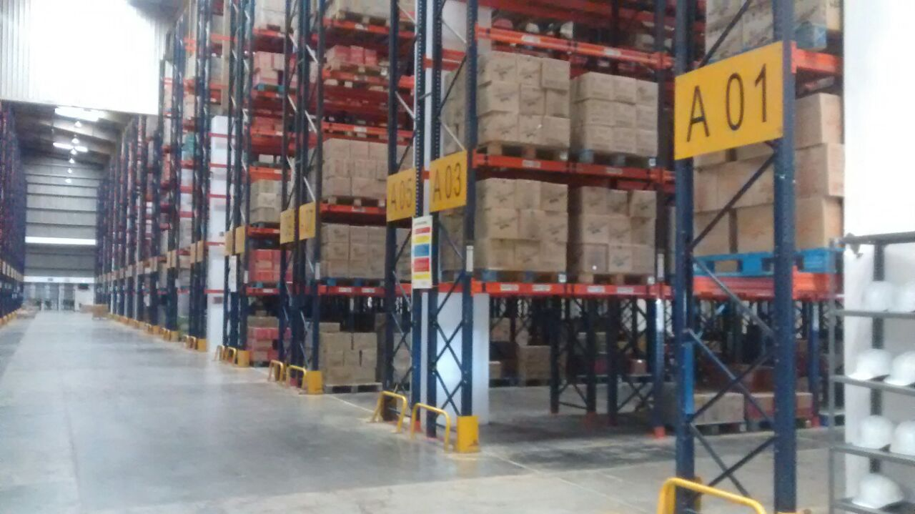
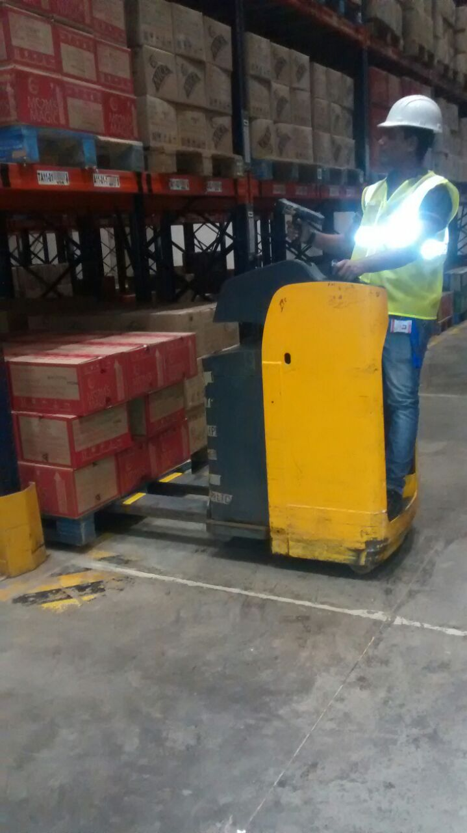
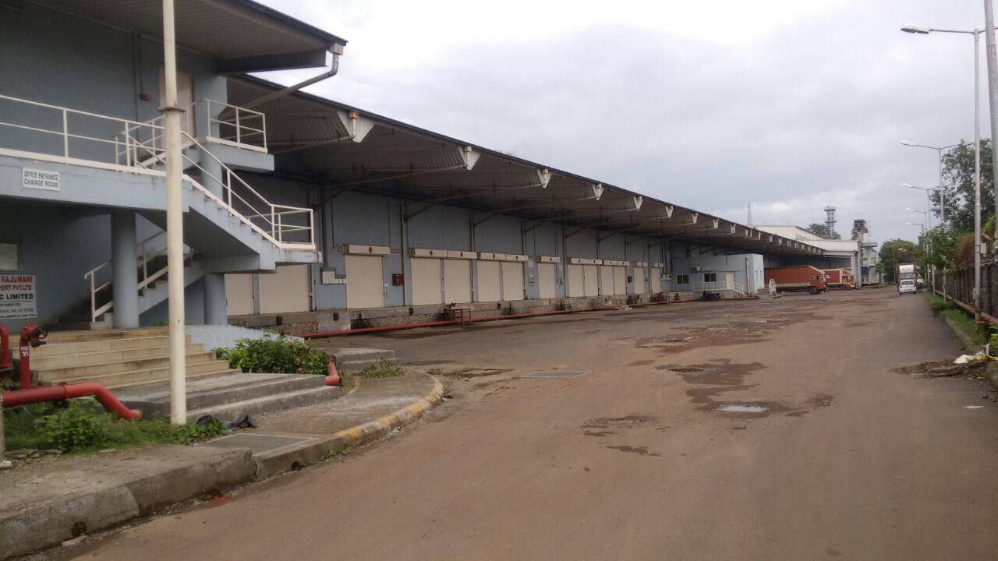
WAREHOUSES MANAGED BY NRTPL

Slide 10
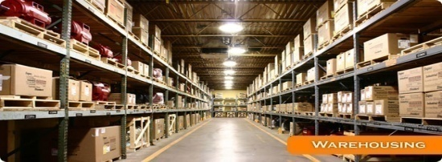
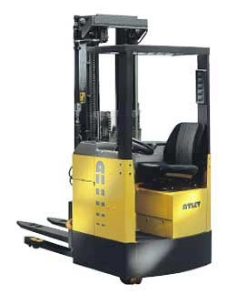
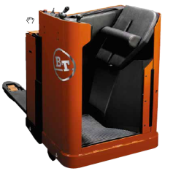
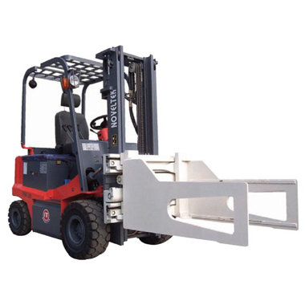
We are ready for Logistics future
RACKING
HRT
BOPT
CLAMP TRUCK

Slide 11


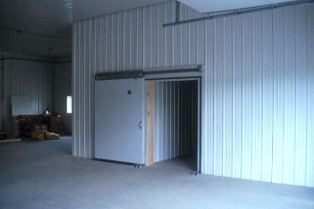
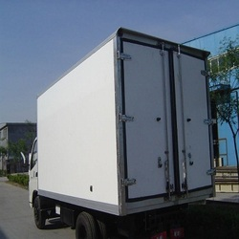
We are ready for Logistics future
CCTV
HHT
COLD STORAGE
INSULATED VEH.

Slide 12

Think Ahead
Thank you

